Slide 1
Software Quality Assurance Plan
MoonEyes: Case Management System for Metro Detective Agency
Team 9: Kylie Callison, Erika Valle-Baird, Kendall Gesek, Pamela Shahu

Slide 2
1.1 Scope and Intent of SQA Activities
The objectives of the SQA team are to ensure project management processes by the development of quality outputs. The SQA team will provide quality assurance by adhering to client design specifications. To guarantee the product meets customer specifications, the SQA team has set up frequent meetings with clients for verification and planning. This was done in an effort to prevent risks that could affect the quality of the final software. Walking through each stage of development with our clients safeguards our software against risks that affect production quality and maintains quality control by sustaining a customer feedback loop. The SQA team sets out to reach its goals of customer satisfaction and defect elimination by monitoring and improving any weaknesses identified in processes. For our team to verify our software is meeting its requirements, adhering to predefined standards, and uncover errors pertaining to function, logic, and implementation, we will be conducting FTRs. FTRs will be conducted via walkthroughs and technical reviews. Due to the size of our team, each team member will employ multi-dimensional roles and will all remain members of the SQA team.

Slide 3
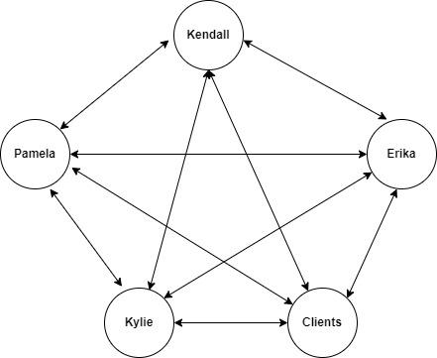
1.2 SQA Organizational Role
Due to the size of our team, each team member will employ multi-dimensional roles and will all remain members of the SQA team. We will employ an egoless team structure in which all members will be involved in decisions and cross reference all work.

Slide 4
2.1.1 SQA Tasks & 2.1.2 Work Products & Documentation
Description of SQA Task | Work Products & Documentation
The team will use the Software Requirements Specification document when developing the back-end of the product to ensure it is following the original design. | Any majors changes are requested or found, there will be a separate change log accessible to all team members with proper documentation for each request in date order.
The team will refer to the SRS when developing the user interface so it is being designed as intended and functioning properly. | Any major changes will be documented in the change log with documentation accessible to all team members in date order, so other elements of the project can be adjusted.
All team members will evaluate the user interface for ease of use, efficiency, attractiveness, error prevention, and consistency in design. This is very important to our client. | Any suggest and concerns can be expressed in a team meeting with a change request. The team will adjust the user interface to verify it is working as intended.
Each team member will test the back end of the product to ensure it is working as designed by looking at logic errors, database management, network availability, etc. | Weekly team meetings will allow for any changes to be discussed among all team members. Any changes are documented in the change request log.
There will be specific team members who lead the SQA process by handling reviews and sharing of information. They will also assign priority levels to change requests. | During each SQA review, all information is documented for future use and will have an assigned ranking for implementation.

Slide 5
2.2 Standards, Practices, and Conventions (SPC)
Close Contact with Client:
Due to client request inconsistencies, close contact with the client will allow our team to improve product quality with frequent meetings discussing all information pertinent to the project. This will allow for almost immediate clarification for any questions our team may have while working on the project. This will also allow for our client to obtain and try our working prototype sooner, allowing for faster turnaround times for correcting any necessary issues. This will both save our team time along with saving our client costs as they will have a working product sooner.

Slide 6
2.3 SQA Resources
We will have specific team members focused on the SQA process and communicate the information to the rest of the team.
These members will be in charge of the priority ranking of each change request with higher priority being given to functional defects.
Each team member will be frequently test the current software product for any defects or enhancements, as well as assisting in the debugging process.
At this time, no additional software or hardware is needed to assist in the quality assurance process but could be added later as the business continues to grow.

Slide 7
3.0 Reviews & Audits
3.1 Conducting a Review
Possible Conclusions
Accept the product fully
Accept the product with small easy modifications
Reject the product to severe errors (must wait for another review)
3.1.2 Roles & Responsibilities
1 Producer, 2 Reviewers(1 Recorder), 1 Review Leader. Possibility for multi-dimensional roles during a FTR
3.1.3 Work Products
Notes, Review Summary Report, Checklist

Slide 8
System Specification Review
Software Project Plan Review
RMMM Review
3.2 Formal Technical Reviews
Review quality, accuracy and effectiveness of the system specification
Takes place during initial development stages
Checklist Examples
Does the system specification align with the Moon Eyes scope?
Does the system specification clearly break up each component into subcomponents?
Review cost & time estimates
Takes place during initial development stages because basis for overall development schedule is needed for basis
Checklist Examples
Has too much or too little time been assigned for any specific component in Moon Eyes?
Have tasks been delegated equally between each team member to each of their abilities?
Review all risks & mitigation actions
Takes place during early in development stages in case of early risk realization
Checklist Examples
Are risks categorized in terms of impact and likeliness to occur?
Is there a clear outline of steps to be taken once a risk is realized?

Slide 9
Requirements Reviews
Data Design Review
Architectural Design Review
3.2 Formal Technical Reviews
Review SRS and requirements
Takes place during initial development stages because use cases need to be established before development
Checklist Examples
Has too much or too little time been assigned for any specific component in Moon Eyes?
Have tasks been delegated equally between each team member to each of their abilities?
Review architecture design and components
Takes place during during design phase because database is needed in order to begin backend development
Checklist Examples
Are all relationships between data structures properly made?
Is the data model clear and comprehensive?
Review & ensure the architectural design clearly defines Moon Eyes structural elements and interfaces
Takes place during design after the data design review so software components can be reviewed
Architecture Decision Description Template - Pressman, Maxim
Checklist Examples
Does the architectural design address and align with all functional requirements?

Slide 10
Interface (GUI) Review
Component Design Review
Code Review
3.2 Formal Technical Reviews
Review visual clarity, accessibility and aesthetics of GUI
Take place during design phase for early assessment
Checklist Examples
Are the design elements such as fonts, colors, and sizing consistent and legible?
Do interactive elements(such as the sidebar) react appropriately to user interaction?
Review correctness of component design
During design phase after architecture design. Bridges gap between architecture and coding
Checklist Examples
Have all subcomponents and details listed in the architecture design been addressed in the component design?
Does this component need to be broken into subcomponents?
Ensure that any major code being pushed is accurate, understandable, quality, and in some cases reusable
This will happen iteratively during development before code changes are pushed to Github
Checklist Examples
Is the code readable and commented with clarity?
Could the code be optimized better?
Is there proper error handling in the code?

Slide 11
Test Specification Review
Change Control Review
3.2 Formal Technical Reviews
Address the accuracy of the test cases and methods and ensure they align with the requirements and scope of Moon Eyes.
This review will occur early in development after the test specification was written. The timing matters for early detection of any problems with test cases.
Checklist Examples
Is each module tested fully?
Is there multiple methods of testing such as block-box and white-box?
Are any tests unnecessary?
Focus on the change control process and any large changes made to the project, maybe even a change discussed in a different FTR
Change control reviews will be done whenever a change request is submitted and before any big changes are pushed to Github.
Checklist Examples
Were any alternative changes raised?
Have risks been evaluated for the new change?
Does this change have the potential to impact another component?

Slide 12
3.3 SQA Audits
Serve as a means to assess if our team is doing everything necessary to maintain high standards of software quality
Discuss how SQA activities have been impacting our project.
Regular assessments(monthly) of our work products from each FTR and ensure that changes listed in the review summary reports have been acted on.
If SQA activity is redundant/not useful, we will revisit
Useful SQA processes will be continued
With a smaller 4-person team, the SQA audits will be less formal or complex compared to larger projects, but they are still necessary in order to maintain the quality of Moon Eyes and ensure that we are meeting our project requirements.

Slide 13

4.0 Reporting and Corrective Action/ Follow-up
4.1 Reporting mechanisms
We will utilize the platform "Trello" for problem reporting. Trello is a free website (www.trello.com) that allows us to assign tasks to group members and track their progress. During the testing process, each member involved will log problems and bugs on Trello. The related members will receive tasks to address these issues, and once resolved, the corresponding card will be moved to the "Fixed Problems" list. The website is accessible from any location and on various devices, providing convenient access for all team members.

Slide 14
4.2 Responsibilities
Software Quality Assurance (SQA) Team
The SQA team plays a central role in identifying, documenting, and addressing defects and issues that arise during testing.After discussing with our team, we decided that Pamela Shahu and Kendall Gesek will cover this section.
Development Team
The development team takes ownership of rectifying the defects and issues reported by the SQA team. After discussing with our team, we decided that Kylie Callison and Erika Valle-Baird will cover this section.
Documentation and Communication
Documentation and communication are essential aspects of effective corrective actions and follow-up. The responsibility for documenting identified defects, proposed solutions, and the outcomes of corrective actions falls on both the SQA and development teams.
Continuous Monitoring and Review
The responsibility for continuous monitoring and review of the corrective action process is shared among the SQA team and development team.

Slide 15
4.3 Data collection and evaluation
The systematic collection and evaluation of error and defect data are vital components of our quality assurance efforts for the web-based detective case management project.
The SQA team is responsible for documenting each reported defect using a standardized format.
To facilitate efficient management and tracking of defect data, a dedicated defect tracking system is utilized.
For immediate response to critical issues, real-time monitoring tools are integrated into our software environment.
Defect data is integrated with our version control system, ensuring that each reported issue is associated with the specific software version or release in which it was identified.

Slide 16
4.4 Statistical SQA
To ensure the high-quality performance of the software we will use different data-based and statistical metrics in the testing phase. According to the mentioned metrics in the use case document, we will use the following metric to monitor and improve the software quality and performance to provide the best experience to the users of the system.
User Adoption Rate
User Engagement Metrics
System Performance Metrics
Error Rate
Search Efficiency
Security and Privacy Metrics

Slide 17
5.0 Software Process Improvement Activities
5.1 Goal and objectives of SPI (Software Process Improvement)
The primary goal is to implement all suggested changes in requirements to enhance software quality and reduce the error rate (number of bugs in the code).
Ensuring that all users find the system comfortable to use and that the interface is user-friendly, enabling them to accomplish desired tasks efficiently.
Ensuring the system is capable of accommodating new functionality and features with ease, facilitating future enhancements.
Ensuring that the software process and development cycle progress on schedule, delivering all the required components on time to avoid any mismanagement of time.
Ensuring that all process and development activities are within the allocated budget and do not exceed the agreed-upon price.
Ensuring that resources are available as needed and procured within the budgetary constraints.
Regularly monitoring all activities and system performance, recording the data to improve system performance and maintain the overall quality of the system.

Slide 18
5.2 SPI tasks and responsibilities
Our commitment to excellence involves a structured approach to Software Process Improvement (SPI), aimed at enhancing our practices, methodologies, and overall effectiveness. The following tasks and responsibilities outline the SQA group's contributions to SPI efforts:
Process Evaluation and Assessment
The SQA group is responsible for conducting thorough evaluations of our existing quality assurance processes.
Process Enhancement and Refinement
To ensure continuous process improvement, the SQA group actively engages in refining existing methodologies and adopting industry-leading practices.
Data-Driven Decision-Making
Leveraging data to drive decisions is fundamental to our SPI efforts. The SQA group plays a crucial role in analyzing defects and testing data to inform improvements.
Process Monitoring and Adaptation
SPI involves ongoing monitoring and adaptation of our quality assurance processes. The SQA group is responsible for ensuring that process improvements are effective and aligned with project goals:
Training and Knowledge Sharing
Elevating the skill set of the SQA team and fostering a culture of knowledge sharing are essential components of SPI.

Slide 19
6.0 Software Configuration Management Overview
Software Configuration Management (SCM) 's focal point is identifying and controlling major software changes as well as recording and reporting the status of the changes.
1: The change request identification, both issue resolution and an impact summary are required to determine the steps that need to be taken to resolve the issue with a focus on how this will impact our system in the future.
2: A change request is logged into the system to track and ensure proper documentation.
3: The team reviews and evaluates the change request to decide how the team will move forward with the change and the viability of it. If the change is deemed beneficial to the program, implementation will occur as well as an update to the log. If the change is denied, a revision can be made to the proposed change request to be reassessed by the team at a later time.
4: If the change is approved, any resources needed for the change will be discussed by the team and added to documentation to ensure completion.
5: The change will be evaluated in a testing area before being implemented into the software system to ensure it is performing as intended.
6: Once the change has been implemented into the system, the maintenance of the change will fall on to the team and verifying all documentation reflects the completion of the change.

Slide 20
7.0 SQA Tools, Techniques, and Methods
Software Quality Metrics:
Customer Satisfaction
One of the product quality metrics we plan to employ is customer satisfaction. This metric will be measured using a five-point scale: Very Satisfied, Satisfied, Neutral, Dissatisfied, Very Dissatisfied. To obtain this metric, surveys will be carried out for each aspect of software that is developed.
Fix Backlog and Backlog Management Index
This maintenance quality metric will be employed using a Trello board, allowing our team to fix defects based on their priority in the backlog. To increase customer satisfaction, customers have access to the aforementioned board and are able to inform our team about requested fixes at any time, leading our team to maintain shorter fix response times.
Fix Quality
Frequent client meetings allow our team to be informed about defects as soon as they are encountered. By eliminating defects as soon as possible, we are able to fix quality, response time, and responsiveness. This quality maintenance metric will be determined by the rate of defective fixes without delinquency.

Slide 21
7.0 SQA Tools, Techniques, and Methods
Quality Indicators
To measure and ensure software quality, the SQA team plans to employ the following quality metrics:
Reliability
Portability
Efficiency
Maintainability
Usability
Security
Performance

Slide 22
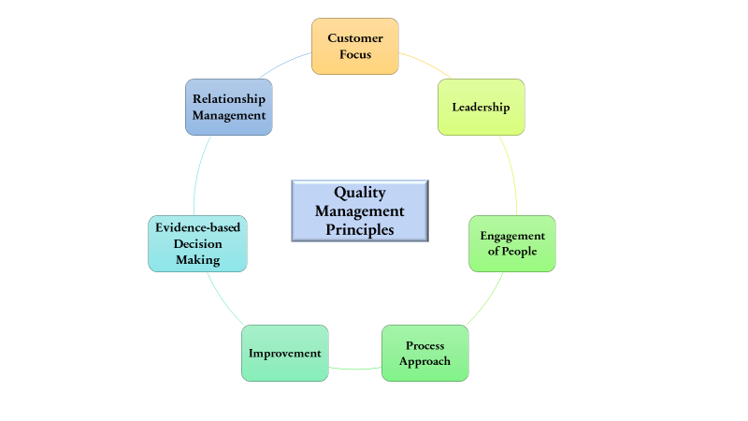
7.0 SQA Tools, Techniques, and Methods
Methods
To better align ourselves with our customer’s needs, we will be enlisting the ISO 9000’s seven principles of quality management.
These principles include:
Customer Focus
Leadership
Engagement of people
Process approach
Improvement
Evidence-based decision making
Relationship management

Slide 23
7.0 SQA Tools, Techniques, and Methods
Customer Focus
With an emphasis on customer focus, our team will be better able to meet customer requirements, measure our customer’s satisfaction with our software quality metrics, and be better adapted at understanding our customer’s needs.
Leadership
By setting and reaching our goals, we can establish trust both within our software team, and with our customers.
Engagement of People
Shared drives, group messages, and meetings ensure learning and information sharing, as well as allowing our team to enlist the right person for each task.
Process Approach
By enlisting a process approach, we can establish activities as processes, allowing our team to prioritize improvements, and manage activities.
Improvement
We will provide Improvement by measuring and empowering our team members to improve our software quality.
Evidence-Based Decision Making
Decisions will be made based on analysis, appropriate methods, and employed tools.
Relationship Management
By constant communication with our clients, our relationship management will consist of honest and open dialogue.

Slide 24
7.0 SQA Tools, Techniques, and Methods
In addition to this, techniques we plan to employ consist of:
Auditing
Reviewing
Code Inspection
Design Inspection
Simulation through prototype
Functional Testing
Standardization (IEEE)
Walkthroughs
Unit testing
Stress testing

Slide 25
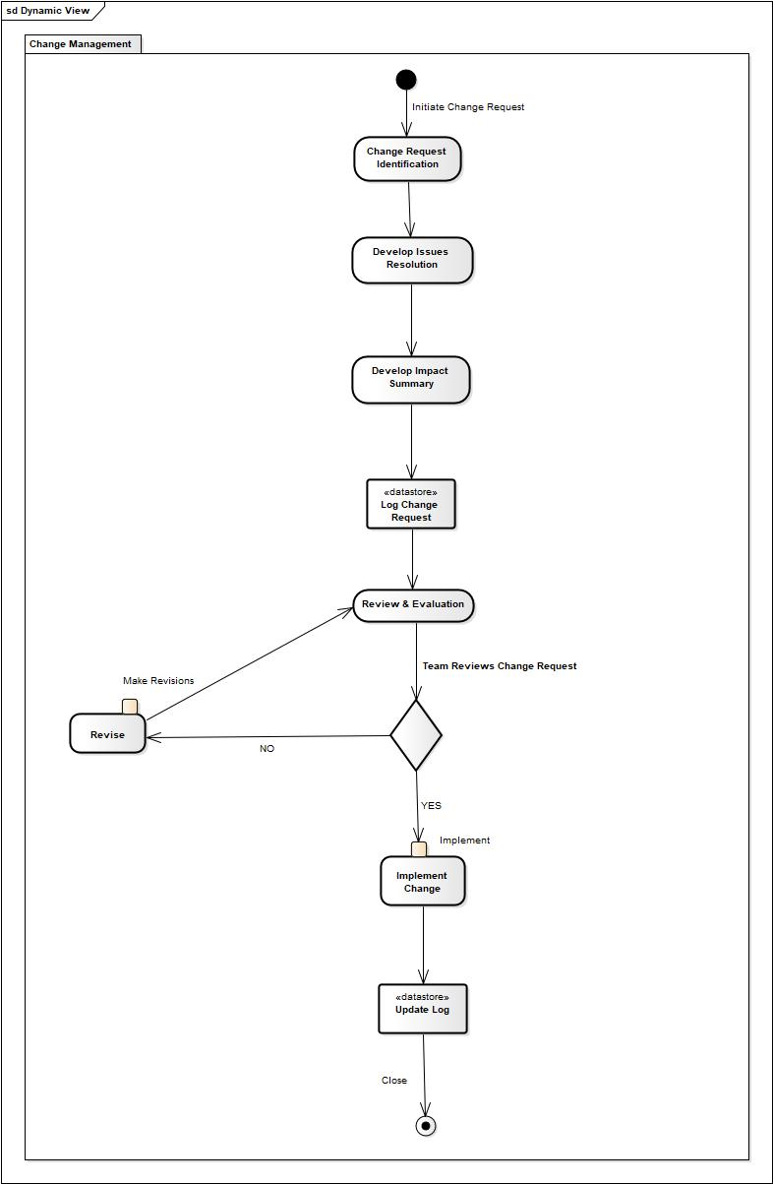
7.0 SQA Tools, Techniques, and
Methods
Change Management Method
In addition to this, provided below is a visual diagram of the method we will employ for all change management activities. Further information on this can be found in the Software Requirements Specification, along with a detailed process walkthrough in the Software Configuration Management Overview.

Slide 26
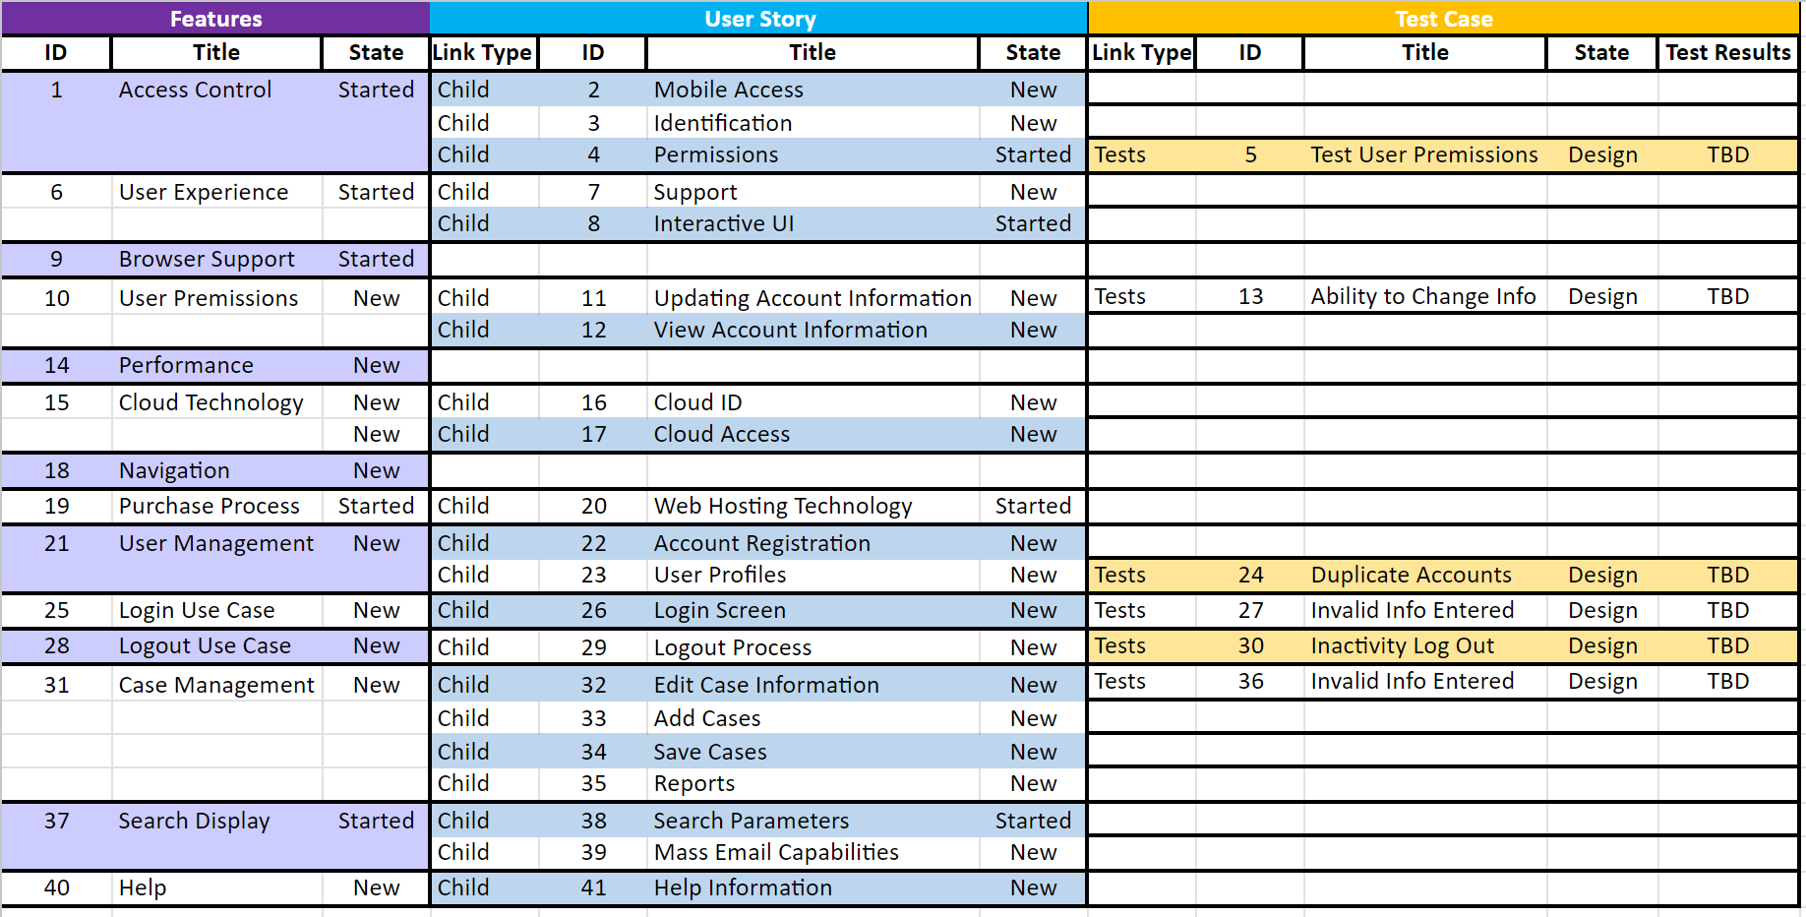
8.1 Traceability Matrix

Slide 27
References
R. S. Pressman, “Document Templates: Software Quality Assurance Plan,” R.S. Pressman & Associates, Inc.. [Online]. Available: http://www.rspa.com/docs/sqaplan.html. [Accessed: 14-July-2023].
Pressman, Roger S., and Bruce R. Maxim. Software Engineering: A Practitioner's Approach . Vol. 9, McGraw-Hill Education , 2020.
R. S. Pressman, “Document Templates: SQA Plan,” R.S. Pressman & Associates, Inc.. [Online]. Available: http://www.rspa.com/docs/sqaplan.html.[Accessed: 14-July-2023].
“Software Quality Assurance Plan,” McGraw Hill Higher Education. [Online]. Available: http://www.mhhe.com/engcs/compsci/pressman/graphics/Pressman5sepa/common/cs1/sqa.pdf.[Accessed: 14-July-2023].
“Software Quality Assurance Plan,” McGraw Hill Higher Education. [Online]. Available: http://www.mhhe.com/engcs/compsci/pressman/graphics/Pressman5sepa/common/cs2/sqa.pdf. [Accessed: 14-July-2023].

